Slide 1

PREDICT 453 Text Analytics: Cohort 9: Assessing Clustering Results Northwestern University SPS Master of Science in Predictive Analytics
u

Slide 2
Purpose
Establish a new hierarchical relationship which explains the ontology of DSIs in current cohorts
Compare the ontology in previous and current cohort to find out how to improve the clustering
Interpret the underlying information enriched in the entire corpus
Provide an unambiguous version of cohort for future work

Slide 3
Text Analytics Process
Ontology – a visualized world-view summary consists of key elements from DSI corpus
Term frequency – occurrence in a given DSI
Document frequency – occurrence in overall DSIs regardless of hits in each
Reference Term Vector (RTV) – representative terms for the full corpus of DSIs
Equivalence classes (EC) – super-terms representing many different expressions of the exact same thing

Slide 4
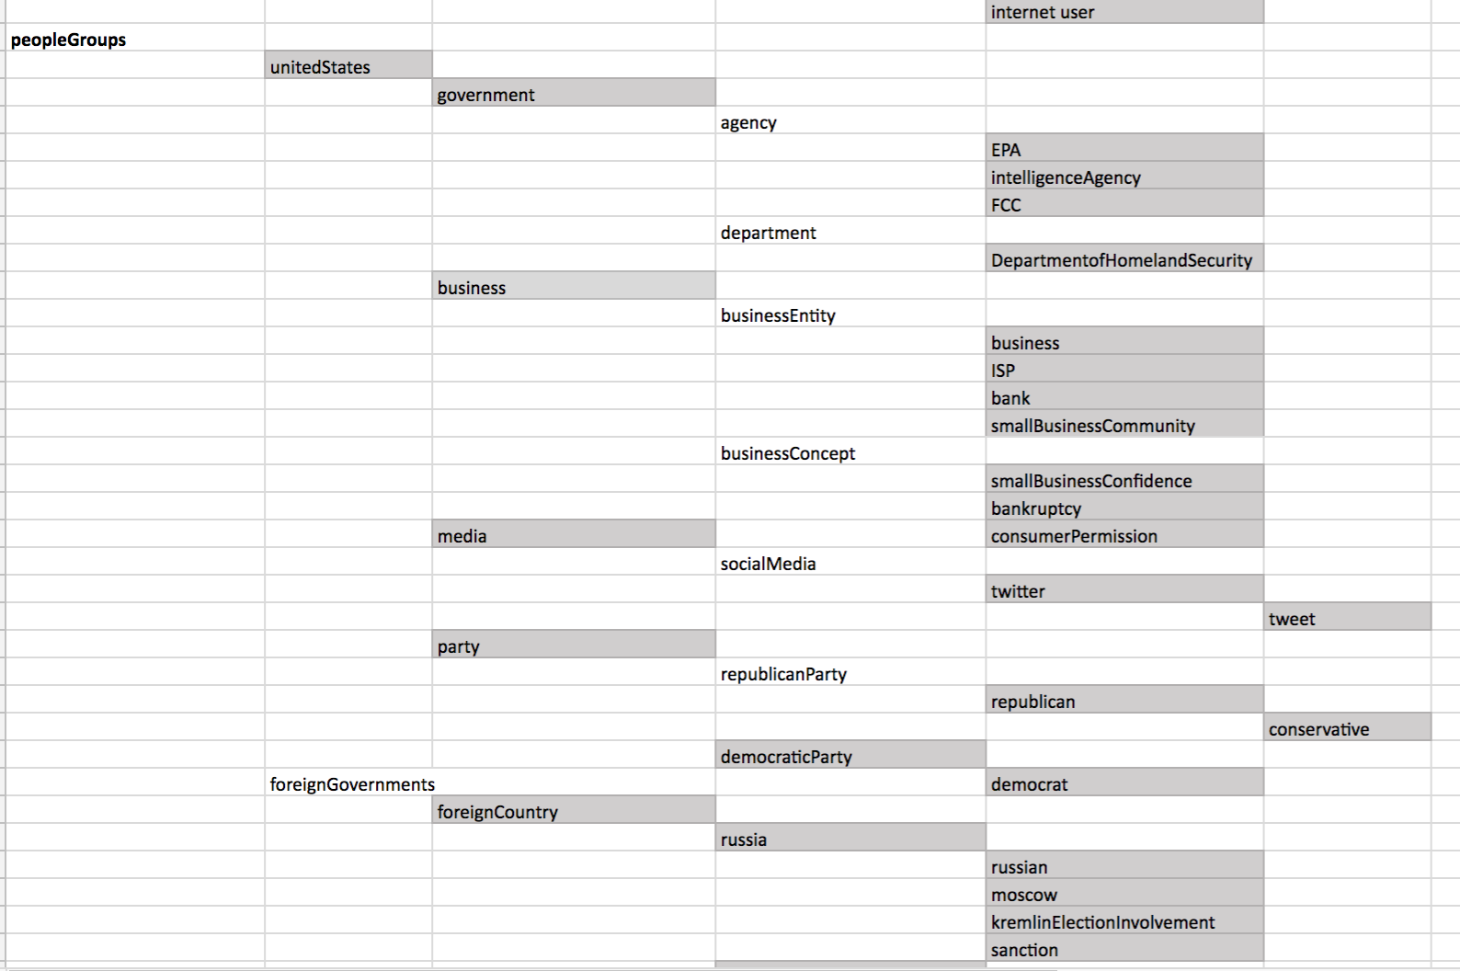
Ontology
wallstreet
stocks
China
currencymanipulator

Slide 5
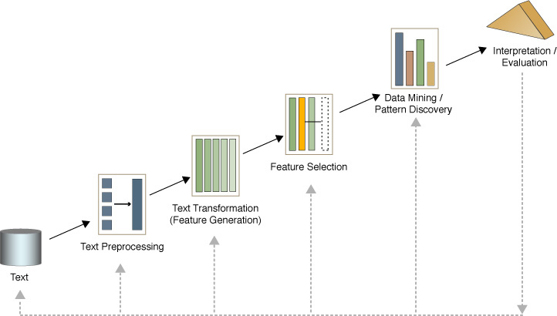
Method
DSI collecting for cohort 9
Term searching, Bag of Words Matrix/Clusters.
RTV initiating
EC generating
Matrix forming
Cluster analysis and interpretation

Slide 6
Term Matrix + Bag of Words
After choosing our DSI’s we added our selections with cohort 7 + 8 resulting in 49 DSI’s
In order to extract concepts we used the R function tm_map. This allowed us to stem words, collapse similar terms, remove verbs and other non-concept words.
The resulting matrix would be very large and also include sparse terms (only 1 mention across the corpus). We removed sparse terms, and set a threshold for importance to remove terms.
The resulting Bag of Words matrix is collapsed from 3211 terms to 100.
This can filtered into an RTV/ontology.
In order to create an RTV, we can use this basic bag of words to create initial clusters which are refined in the RTV stage.

Slide 7
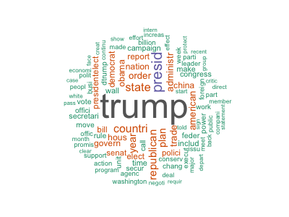
Bag of Words Concepts
Resulting Concepts are messy, many words are useless without context
Concepts can be used to cluster DSI’s together
The resulting clusters + matrix can be refined into RTV/ontologies

Slide 8
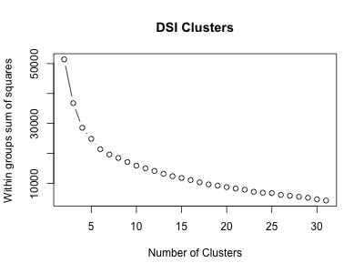
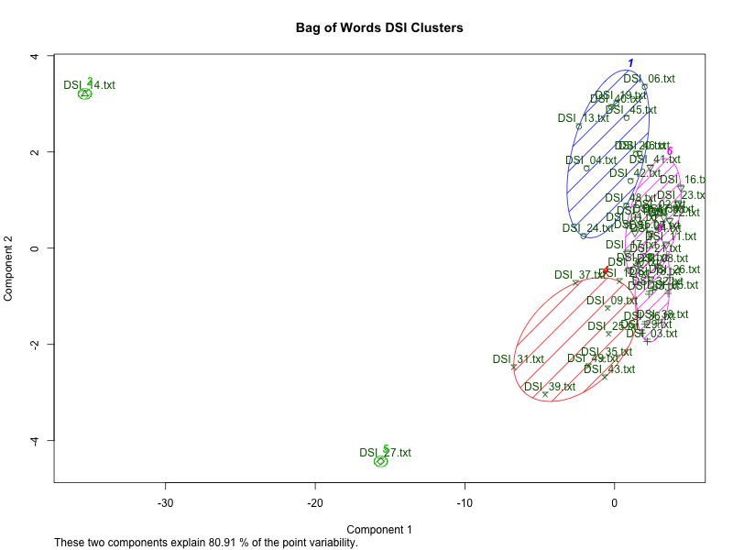
Bag of Words Clusters
Elbow plot suggests roughly 6 clusters

Slide 9
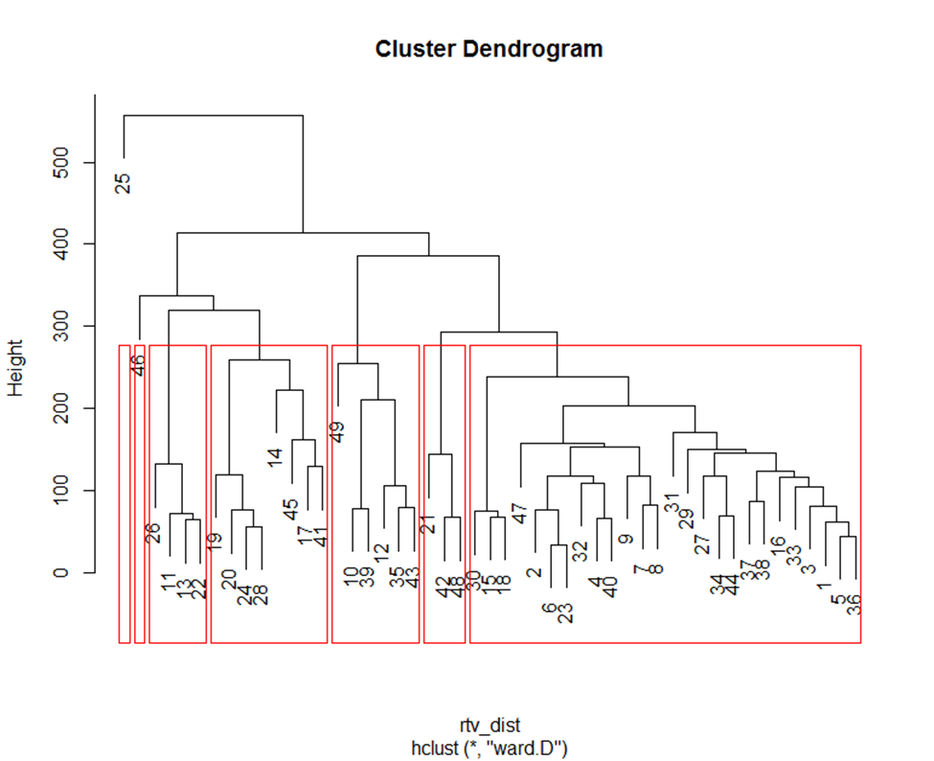
First Round RTV
C1 DSIs: 1,2,3,4,5,6,7,8,9,15,16,18,23,27,29,30,31,32,33,34,36,37,38,40,44,47 = 26 DSIs
C2 DSIs: 11,13,22,26 = 4 DSIs
C3 DSIs: 14,17,19,20,24,28,41,45 = 8 DSIs
C4 DSIs: 10,12,35,39,43,49 = 6 DSIs
C5 DSIs: 21,42,48 = 3 DSIs
C6 DSIs: 46 =1 DSI

Slide 10
Expected Cluster: Discussion 7
Cluster1: Domestic Affair/Policy/ Healthcare
DSI: 1, 3, 4, 5,9,10,12,17,18,25,29,30,32,33,34,35,36,39,43,44,49
Cluster2: Foreign Affair/Policy
DSI: 8,11,15,27,31,37,38,42, 46,47,48
Cluster3: Energy/Climate Change
DSI: 19,20,21,24,28,41
Cluster4: Other. (This cluster is mostly related to Trump's personal issues/points of view)
DSI: 6, 14,16,23,40
Cluster5: Russia
DSI: 13,22,26,
Cluster6: Economics Issues
DSI: 7,45

Slide 11
Expected Cluster: Discussion 7
Based on Discussion 7: Estimate Likely Clusters, there are 6 clusters. The biggest cluster is Cluster 1 with Domestic Affair/Policy/Health. It includes 21 DSIs which is close to half of the total 49 DSIs.
Cluster 2 is the second largest cluster regarding Foreign Affair/Policy with 12 DSIs included.
Cluster 3 is about Energy/Climate Change. It contains 6 DSIs. This cluster mostly talks about the Paris agreement.
Cluster 4 includes Donald Trump’s personal issues/point of view on different issues. DSI 6 talks about Trump will dissolve his foundation to avoid conflict of interest; DSI 14 talks about Trump’s conflict interest after becoming president.
Cluster 5 is associated with Russia-related issues, which only contains 3 DSIs.
Cluster 6 is the last one with 2 DSIs and focuses on the economy.

Slide 12
Expected Cluster: Second Round RTV
Cluster1: Domestic Affair
Cluster2: Foreign Affair
Cluster3: Business
Cluster4: Economy
Cluster5: Healthcare
Cluster6: Environment
Cluster7: Other

Slide 13
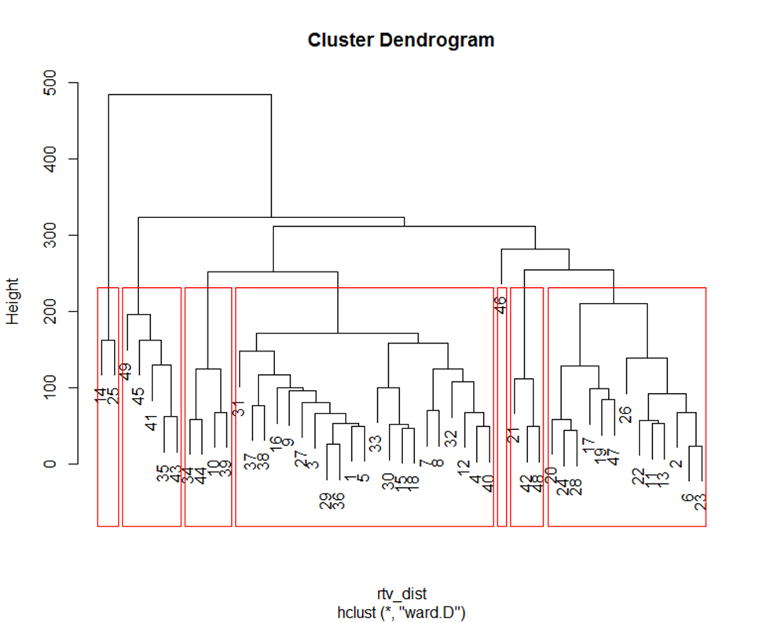
Second Round- Cluster Results
C3
C5
C4
C6
C1
C2
C1 DSIs: 1,3,4,5,7,8,9,12,15,16,18,27,29,30,31,32,33,36,37,38,40 = 21 DSIs
C2 DSIs: 2,6,11,13,17,19,20,22,23,24,26,28,47 = 13 DSIs
C3 DSIs: 10,34,39,44 = 4 DSIs
C4 DSIs: 14, 25 = 2 DSIs
C5 DSIs: 21,42,48 = 3 DSIs
C6 DSIs: 35,41,43,45,49 = 5 DSIs
C7 DSIs: 46 =1 DSI

Slide 14
Second Round Cluster 1
Cluster 1 | Keywords
Trump immigration plan mirrors post-9/11 policy | TBD
Donald J. Trump Contract with the American Voter | worker, healthcare, education, infrastructure, immigration
Tax cuts are coming, but maybe not as big as Trump promised | tax, cuts, plan, income
Trump’s First 100 Days: Science Education and Schools | Trump, education, STEM, school choice policy, Obama
Trump Puts Auto Makers, Trade Policy in Spotlight | Ford, tariffs, imports, cars, Mexico
Trumps ambitious 100-day agenda staring at political reality | Trump, Immigration, China, Mexico, Republicans
The Right Way to Rebuild America’s Infrastructure | Infrastructure, spending, policy, Trump, projects
GOP leaders face crunch in Trump's first 100 days | budget GOP Trump appropriations committee
Trump Insists Mexico Will Pay for Wall After U.S. Begins Work | Trump, immigration, wall, NAFTA, taxpayers
Donald Trump's first 100 days: A breakdown of his plan | Trump, immigration, TPP, NAFTA, climate, regulations, cyberattack
House GOP, Trump team hatch border wall plan | Border, wall, Trump, Republicans, Mexico
Executive Order Protecting The Nation From Foreign Terrorist Entry Into The United States - SECTION 2 | Trump, immigration, policy, travel, ban
Trump expected to sign bill allowing internet providers to sell user web data | Internet Service Providers, Privacy, Personal Information, VPN, Advertising
Exclusive - Trump border 'wall' to cost $21.6 billion, take 3.5 years to build: internal report | Trump, wall, costs, border and construction
To reduce trade deficit, White House wants partners to buy American | Trump, Partners, Trade, Deficit, American
The President Changed. So Has Small Businesses’ Confidence. | Trump, Obama, regulation, taxes, small-business
Trump's budget overhaul: domestic programs slashed to fund military | budget, wall, priorities, cuts, Trump
The Real-Life Consequences of the Federal Hiring Freeze | uncertainty, hiring, freeze, jobs, government
South Korea Seeks to Dispel Misunderstanding of FTA with U.S. | Trump, NAFTA, free-trade, tariff/tax, import/export
Tillerson on North Korea: Military action is 'an option' | Korean Peninsula, China, Nuclear, Policy, Military
In Past Failures, A Possible Roadmap For Trump | Failure, Healthcare, Bipartisan, Bankruptcy, Reframing

Slide 15
Second Round Cluster 2
Cluster 2 | Keywords
Trump 'arms race' comment sows more doubt on nuclear policy | Trump, Putin, US, Russia, Nuclear
Trump say he’ll dissolve foundation | Trump, Dissolve, Foundation, Conflict, Untangle
Russia-US row: Trump praises Putin amid hacking expulsions | Donald Trump, Vladimir Putin, hack, diplomats, Barack Obama
Donald Trump's face-off with spy chiefs on hacking comes to a head | Trump, Russia, Hacking, Intelligence, Putin
Trump Opposition sets up blue-state headquarters | Opposition, law, democratic, Trump, mayors
Here’s where Donald Trump stands on energy issues | Trump, energy, coal, environmental policy, Obama
Trump’s First 100 Days: Climate and Energy | Trump, Climate, EPA, Energy, Environment
Trump acknowledges Russia role in U.S. election hacking: aide | Trump, Russia, intelligence, cyber, Putin
Trump invokes 'fake news' at press conference | Trump, News, Media, Fake
Energy independence, not climate change, becomes priority under Trump order | Climate, American, Energy, Coal, Environment
Trump Russia dossier key claim 'verified' | Russia, FBI, dossier, intelligence, investigate
Trump issues executive order rolling back Obama climate change policies | Climate change, jobs, environmental, clean energy, Paris accord
Trump Reverses Pieces of Obama-Era Engagement With Cuba | Mr, Cuba, Trump, Obama, Travel

Slide 16
Second Round Cluster 3
Cluster 3 | Keywords
Trump Eyes Two Seats on the Supreme Court | Trump, court, Scalia, conservative, liberal
Trump tweets on "so-called judge" after travel ban stay | Trump, judge, ban, security, country
Home stretch for Trump’s Supreme Court nominee could forever alter the Senate | Supreme Court, confirmation, filibuster, partisan
Trump's lawyers make final plea to Supreme Court on travel ban, with eye toward Justice Kennedy | Travel, Ban, Justices, Ruling, Courts

Slide 17
Second Round Cluster 4 and 5
Cluster 4 | Keywords
Donald Trump's Conflicts of Interest: A Crib Sheet | (missing)
Daily Press Briefing by Press Secretary Sean Spicer - #28 | AHCA, KeystoneXL, Charter Communications, Vote, Insurance
Cluster 5 | Keywords
China Takes the Climate Spotlight as U.S. Heads for Exit | China, Paris, Trump, U.S.
China’s Trump Honeymoon: Unexpected, and at Risk of Ending | china, north korea, trump, xi, relationship
Trump to China: Thanks for trying with North Korea | Trump, North, Korea, China, President

Slide 18
Second Round Cluster 6 and 7
Cluster 6 | Keywords
Trump can’t stop the Freedom Caucus. He has GOP gerrymandering to blame | Meadows, caucus, gerrymander, district, election
Was Trump’s Paris Exit Good Politics? | withdrawal, base, support, economic, polls
The surprising GOP holdout on the Senate’s health bill | healthcare, premiums, negotiation, Johnson, Senate.
Why Is Trump Causing Chaos In Washington But Not In The Stock Market? | Hit, High, Uncertainty, Fear, Market
Why The GOP Is So Hell-Bent On Passing An Unpopular Health Care Bill | GOP, Republican, Health Care Bill, Obamacare
Cluster 7 | Keywords
On immigration, Trump has plenty to show in 100 days | Trump, immigration, sessions, wall, Mexico

Slide 19
Second Round Clusters
Cluster1 – Domestic policy and Business issues
Cluster2 – Health care
Cluster3 – Russia scandal
Cluster4 – Energy and Environmental policy
Cluster5 – Foreign diplomacy
Cluster6 – Health care/Economics
Cluster7 – Immigration/Travel ban
Expected Cluster: Second Round RTV
Cluster1: Domestic Affair
Cluster2: Foreign Affair
Cluster3: Business
Cluster4: Economy
Cluster5: Healthcare
Cluster6: Environment
Cluster7: Other

Slide 20
Expected Cluster: Discussion 7
Cluster1: Domestic Affair/Policy/ Healthcare
DSI: 1, 3, 4, 5,9,10,12,17,18,25,29,30,32,33,34,35,36,39,43,44,49
Cluster2: Foreign Affair/Policy
DSI: 8,11,15,27,31,37,38,42, 46,47,48
Cluster3: Energy/Climate Change
DSI: 19,20,21,24,28,41
Cluster4: Other. (This cluster is mostly related to Trump's personal issues/points of view)
DSI: 6, 14,16,23,40
Cluster5: Russia
DSI: 13,22,26,
Cluster6: Economics Issues
DSI: 7,45

Slide 21
Expected Cluster: Second Round RTV
Cluster1: Domestic Affair
Cluster2: Foreign Affair
Cluster3: Business
Cluster4: Economy
Cluster5: Healthcare
Cluster6: Environment
Cluster7: Other

Slide 22
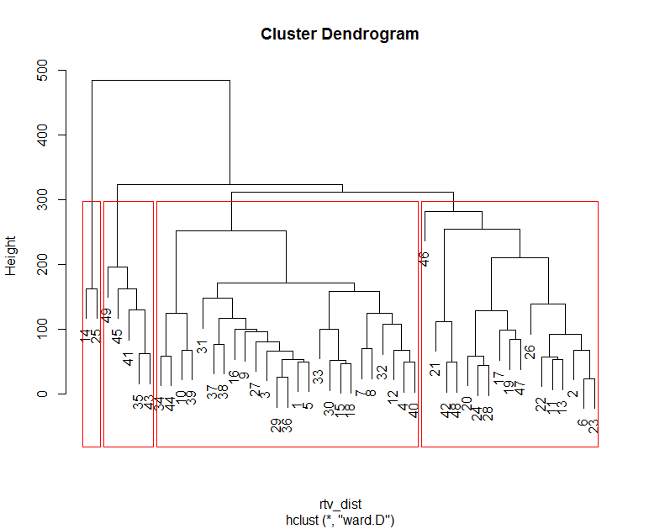
4 Clusters
C3
C4
C1
C2
C1 DSIs: 1,3,4,5,7,8,9,12,15,16,18,27,29,30,31,32,33,36,37,38,40,10,34,39,44 = 25 DSIs
C2 DSIs: 2,6,11,13,17,19,20,22,23,24,26,28,47,46,21,42,48 = 17 DSIs
C3 DSIs: 14,25 = 2 DSIs
C4 DSIs: 35,41,43,45,49 = 5 DSIs

Slide 23
4 Clusters Result
Second Round Cluster 3 was combined into Cluster 1. Travel ban was added into Domestic Policy.
Cluster 5 and 7 were combined into Cluster 2. Foreign policy and immigration was added into Russia scandal.

Slide 24
K Means Approach
Uses RTV and Term matrix to create k means clusters
Use of Elbow plot to pick number of clusters
Cluster plot to view which DSI’s overlap
Used early in the process to identify possible clusters, using bag of words approach.

Slide 25
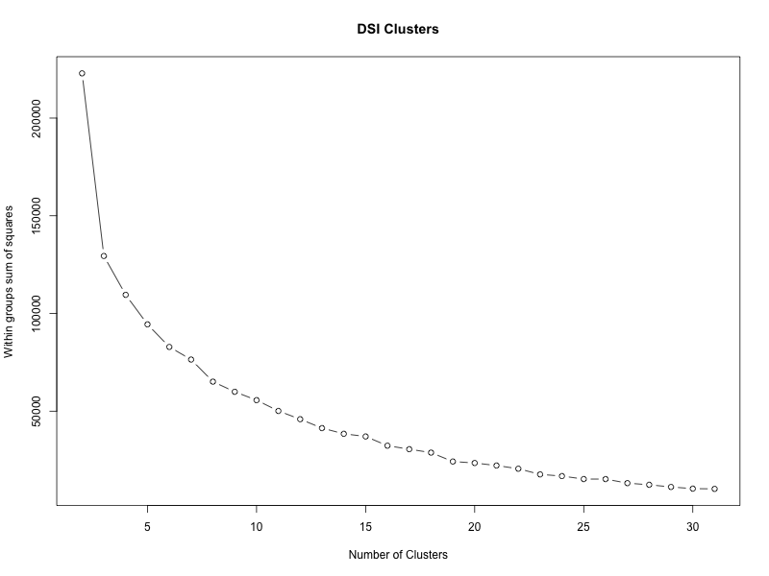
Elbow plot
‘elbow rule’ indicates 4 clusters.
HC selected 7 clusters
More than 7 would tend to over-fit

Slide 26
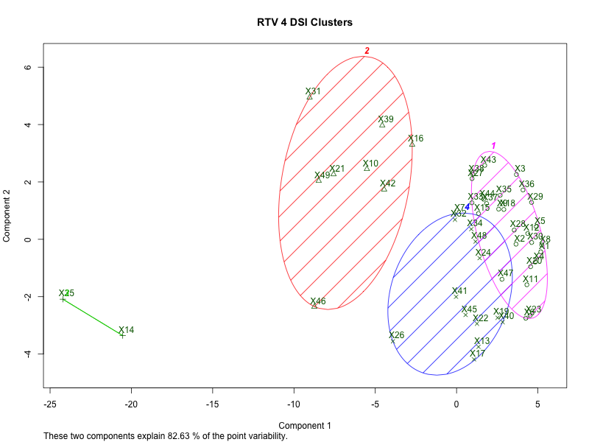
Cluster Plot w 4 Clusters
Elbow plot approach has nice cluster plot, but concepts overlap greatly and encompass disparate concepts.

Slide 27
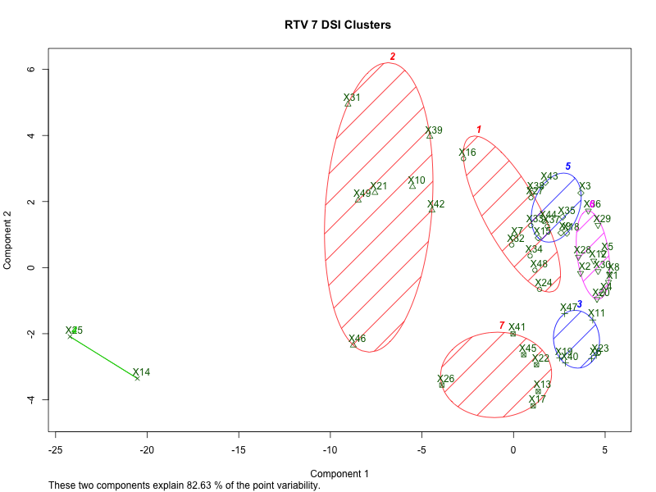
Cluster Plot w 7 Clusters
K means clusters with many clusters, can result in different clusters results*
The below can be used to understand distance between DSI’s
Labels are subjective and are for reference use in creation of RTV’s
Domestic Affairs
China
Foreign Affairs
Business / Regulation
Other
Russia
* HC clust selected slightly different clusters vs k means.

Slide 28
Analysis
The clustering result from cohort8 contains ambiguous information. Each cluster seems quite random not topic-related; the RTV list has many duplicates.
Current clustering result are more closer to the expected one, comparing to previous clustering based on 1st round RTV.
5 clusters make more sense in this case since the expected cluster 5 (Russia) could be included in cluster 2 (Foreign Affairs).
Some DSIs are not expected, which may get improved by removing some popular ECs, like ‘president’.
Overall the analytics provide us the relationship between these terms with information contained in these topics
One of the limitation is that only 9 new DSIs were added on to 40 old ones, which may not influence the ontology a lot.

Slide 29
RTV comparison
New EC

Slide 30
Clustering results comparison

Slide 31
Summary
Text analytics requires a combination of human intuition and machine learning
Ontologies that layer concepts provide a strong base for clustering after gathering key terms
Clustering and unsupervised methods combined with human intuition provide the best results

